Slide 1
LATORREY WHITEHEAD
Interview Demo: The Work Already Speaks
Solutions Architect / Pre-Sales Engineer — a live walkthrough of a Honeywell-specific
platform build, not a pitch deck.
FOUNDER & SOLUTIONS ARCHITECT, TSM CONSULTZ
INTERNAL HONEYWELL IT
PHOENIX, AZ
SEPTEMBER 2026
Notes:
OPEN WIDE. "This is a 55+ application platform, 7 verticals, solo-built, live in production." I didn't build a slide deck about what I could do — I built the platform, pointed it at Honeywell specifically, and I'm walking you through something that's already running.

Slide 2
WHO'S PRESENTING
The Bridge Between Architecture and the Deal
PROFESSIONAL SUMMARY
CORE COMPETENCIES
Founder & Solutions Architect — TSM Consultz LLC (2024–Present) Independently designed, built, and deployed a 55+ application, 7-vertical AI decision-intelligence platform end to end — architecture, integration, and production deployment.
IT Support Technician — Honeywell Technologies (2026–Present) Current internal Honeywell employee — firsthand exposure to Honeywell's technical environment, tools, and internal culture.
Prior: Field Nation, AECOM, Intuitive Surgical, Western Alliance/JPMorgan/BofA — enterprise IT support across regulated, high-security environments.
› Solution Architecture & System Design
› Technical Pre-Sales & Customer Demos
› Translating Requirements into Architecture
› AI/Automation Platform Integration
› Cross-Functional & Customer-Facing Communication
› CI/CD & Cloud Deployment (Node.js, Fly.io, GitHub Actions)
› Regulatory & Compliance Fluency
AWS Certified Cloud Practitioner · Cisco Certified Support Technician · AHIP Medicare Sales Certified · AZ Life, Health & Accident License
TSM CONSULTZ · LATORREY WHITEHEAD
02 / 13
Notes:
I'm not pitching from outside — I'm already inside Honeywell's IT org, so there's zero ramp time on culture or tools. My background spans regulated, high-security environments (JPMorgan, BofA, Intuitive Surgical, AECOM) — that's the credibility layer under everything that follows.

Slide 3
WHY THIS ROLE, SPECIFICALLY
What the Req Asks For — and Where I Already Am
Honeywell's Solutions Architect / Pre-Sales Engineer postings (Productivity Solutions & Services) describe the job as being:
“A go-to person who bridges the gap between technology, product strategy, and integration into the customer's environment.”
Technology
Designed & shipped a 55+ app AI platform, solo — architecture, integration, deployment.
Product strategy
Wrote and ran a full 30-minute stakeholder pitch: hook, 6-vertical fast pass, anchor chain, close.
Integration into the customer's environment
Built a Honeywell-specific vertical (Plant / Supplier / Cyber-OT) before ever being asked to.
TSM CONSULTZ · LATORREY WHITEHEAD
03 / 13
Notes:
WOW-FACTOR FRAME: three things the req asks for, three things I already did — including the third row, which lands hardest: I built a Honeywell-specific vertical before I was ever asked to. That's the proactive-initiative signal, say it plainly and let it sit.

Slide 4
THE PLATFORM, IN NUMBERS
TSM Shell — Built, Deployed, and Running
55+
7
1
Fly.io
APPLICATIONS
BUSINESS VERTICALS
SOLO BUILDER
LIVE PRODUCTION DEPLOY
VERTICALS
Healthcare RCM
Construction
FinOps
Insurance
Legal
Real Estate / Mortgage
BPO Services
Honeywell (5 Incident Types)
Every vertical runs the same three-layer chain: War Room (operator desk, live engines) → Strategist (analytical handoff) → Executive Portal (decision + client-package export). Architecture verified against the live HTML/JS, not assumed — see MASTER_VERTICAL_WALKTHROUGH.md in the repo.
TSM CONSULTZ · LATORREY WHITEHEAD
04 / 13
Notes:
Scale + credibility in one breath: 55+ apps, 7 verticals, solo builder, live on Fly.io — not a mockup, a production system with uptime. Point at the Honeywell chip: 5 incident types, more than any other vertical, because Honeywell's incidents genuinely have different first responders. That's the bridge into Exhibit A.

Slide 5
EXHIBIT A — BUILT BEFORE I WAS ASKED
The Honeywell Vertical: Five Incident Front Doors
Unlike every other vertical in the platform, Honeywell has five parallel front doors — because plant, supplier, cyber-OT, BESS/Gigafactory, and advanced-detection events have genuinely different first responders — converging on one shared strategist and one executive view.
PLANT
INCIDENT
SUPPLIER
SHUTDOWN
CYBER-OT
INCIDENT
BESS /
GIGAFACTORY
ADVANCED
DETECTION
plant-incident.html
supplier-shutdown.html
cyber-incident.html
bess-gigafactory-incident.html
advanced-detection-incident.html
HONEYWELL STRATEGIST
honeywell-strategist.html — 6-engine analysis per incident type
HONEYWELL EXECUTIVE PORTAL
honeywell-executive-portal.html — AUTHORIZE / BOARD NOTIFIED / EXPORT CLIENT PACKAGE
BESS and cyber-OT share the platform's top severity tier (CRITICAL) in the strategist's own scoring logic — a real code-level decision, not a demo convenience.
TSM CONSULTZ · LATORREY WHITEHEAD
05 / 13
Notes:
Five front doors, one architecture. Plant, Supplier, Cyber-OT, BESS/Gigafactory, Advanced Detection — five genuinely different first-responder paths that all converge on one Strategist and one Executive Portal. This is proof I can design for real organizational complexity, not a toy flow. Note out loud: BESS and cyber-OT share the platform's top severity tier in the strategist's own scoring logic — a real code-level decision, not a demo convenience.

Slide 6
EXHIBIT A2 — HONEYWELL'S OWN PRODUCT LINES, BUILT IN
Advanced Detection & BESS/Gigafactory
These two war rooms are named after Honeywell's own product lines, not generic scenarios — they reason about the sensor technologies by name.
📡 ADVANCED DETECTION
🔋 BESS / GIGAFACTORY
advanced-detection-incident.html
bess-gigafactory-incident.html
“Early-warning detection alert — VESDA / Li-ion Tamer sensor network — command center engaged”
“Critical incident active — BESS/Gigafactory event detected — command center engaged, all engines standby”
INTAKE TYPES
6 ENGINES
BESS Off-Gas Alert · Gigafactory Off-Gas Alert · VESDA Particulate Alert · Facility Shutdown Log
Incident Intel · Thermal/Off-Gas Impact · Root Cause · Exposure Calc · Action Planner · Exec Dispatch
6 ENGINES
ADVANCED DETECTION REFERENCE (built into this page)
Detection Intel · Facility Impact · Failure Progression — how far from thermal runaway · Exposure Calc · Response Plan · Exec Dispatch
Li-ion Tamer — off-gas sensing for early lithium-ion thermal-runaway warning, ahead of visible smoke or heat.
VESDA — aspirating smoke detection for gigafactory clean rooms and large open floor plans.
Tracks Risk Score, $ Exposure, and Detection Lead Time — the margin between sensor alert and visible fire.
This page links out with its own “↗ Open Honeywell Advanced Detection track” button — the two war rooms are cross-referenced by design.
TSM CONSULTZ · LATORREY WHITEHEAD
06 / 13
Notes:
WOW MOMENT: it speaks Honeywell's own language, not generic vendor-speak. VESDA, Li-ion Tamer — these war rooms are named after Honeywell's actual product lines, not "Incident Type 3." That's domain fluency a generic platform demo can't fake. Let this slide breathe before moving to the live screens.

Slide 7
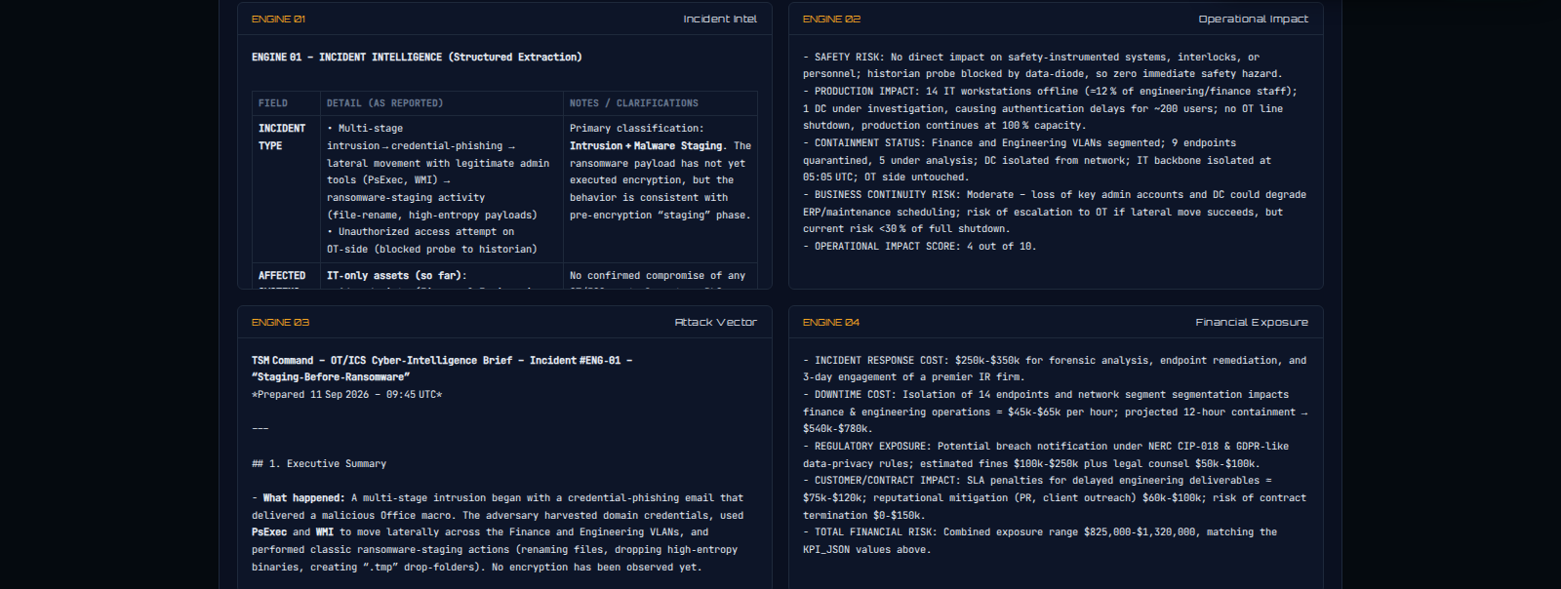
EXHIBIT A — LIVE SCREEN 1 OF 2
Honeywell Strategist: 6-Engine OT/ICS Analysis
SCENARIO LOADED
Phishing credential compromise in Finance → lateral movement across 14 IT endpoints → blocked probe toward the plant historian (IT/OT data diode holds).
WHY IT MATTERS TO THIS ROLE
› 6 parallel engines: intel, safety impact, attack vector, financial exposure, containment, exec dispatch
› IT/OT boundary language (data diode, historian, VLAN isolation) — Honeywell's own domain
› Every KPI traced to source: “read directly from kpis.exposure — not recomputed on this page”
TSM CONSULTZ · LATORREY WHITEHEAD
07 / 13
Notes:
Go deep on this exhibit — walk the 6-engine OT/ICS analysis live if possible. Narrate the data diode / historian logic out loud: the blocked probe toward the historian means the diode's one-way policy held, no confirmed OT-side compromise. This is the "he actually understands our domain" moment. Land the KPI-traceability line: every number is read directly from source, not recomputed on this page.

Slide 8
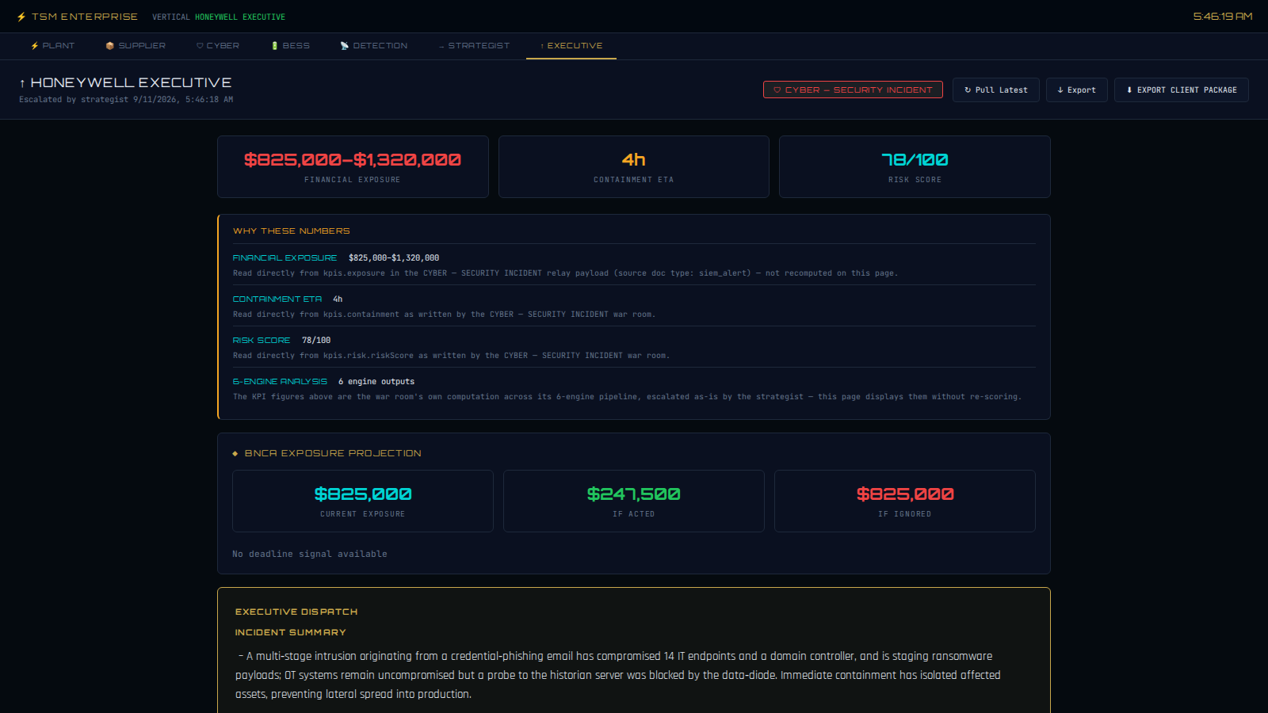
EXHIBIT A — LIVE SCREEN 2 OF 2
Executive Portal: From Analysis to Signed-Off Decision
THE PITCH, IN ONE SCREEN
$825K–$1.32M financial exposure and a 4-hour containment ETA, escalated automatically from the strategist — next to three numbered decisions, each with an owner, a deadline, and a cost.
1
Authorize forensic investigation & threat-hunt
CISO · 12h · $300,000
2
Escalate to legal & compliance for breach notification
VP Compliance · 24h · $150,000
3
Approve patching & access-hardening budget
CTO · 48h · $75,000
TSM CONSULTZ · LATORREY WHITEHEAD
08 / 13
Notes:
Land the exec portal: $150K financial exposure and a 1-day containment ETA, escalated automatically from the strategist — next to five numbered decisions, each with an owner, a deadline, and a cost. Analysis to signed-off decision in one screen. This is the piece a VP actually reads.

Slide 9
EXHIBIT B — THE PRESALES MOTION, NOT JUST THE BUILD
I Already Wrote and Ran the Pitch
A full 30-minute live-demo talk track, written for a Honeywell AI Ops audience — format: live demo, no slides.
0:00
3:00
15:00
27:00
31:00
Open + Frame
6-Vertical Fast Pass
BPO Anchor Chain
Neural Core + WIP
Q&A + Close
The hook: “more dashboards than direction” — document router demo
Healthcare, FinOps, Insurance, Construction, Legal, Real Estate — 2 min each
Understand → Decide → Execute → Trust, with 3 parallel scenario simulations
Cross-vertical signal intelligence and execution tracking
Deployment timeline, governance model, and a scoped next step
GOVERNANCE LINE I BUILT INTO THE DEMO ITSELF
“The ESCALATE button is grayed out while the models run — it only activates when the analysis is complete. Nothing escalates until the system is ready. That's not a UI detail. That's a governance principle.”
TSM CONSULTZ · LATORREY WHITEHEAD
09 / 13
Notes:
Pull back to discipline: this isn't a demo I patched together for today — I already wrote and ran a full 30-minute stakeholder pitch for this platform before this interview ever existed. Then land the governance line verbatim: "The ESCALATE button is grayed out while the models run — it only activates when the analysis is complete. Nothing escalates until the system is ready. That's not a UI detail. That's a governance principle." This lands hard with a safety/OT-culture company.

Slide 10
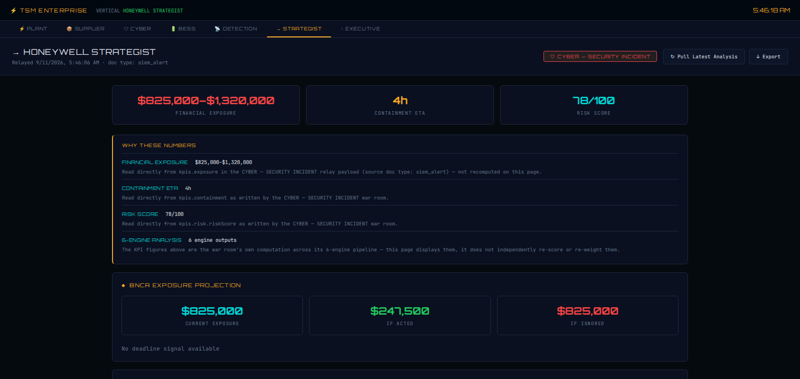
EXHIBIT C — WHERE THE DAY JOB AND THE PLATFORM MEET
L1 Ticket Copilot: The Same Discipline, Pointed at IT Ops
Four connected apps for internal IT operations — the same relay-once, read-everywhere pattern that powers every vertical, applied to the tickets, VMware environments, and topology I already work with day to day.
1
Enterprise Command Center
Hub — links to the other three apps; AI assistant one click away on every page
2
L1 Ticket Copilot
Enter an incident number, open the VMware SME module
Same platform, same KPI-traceability discipline — shown here on the Honeywell Strategist screen.
3
VMware Copilot
DIRECTLY RELEVANT BACKGROUND
Context banner and Component/Category/Environment dropdowns pre-filled — relay write, not re-typed
Field Nation: enterprise migrations (imaging, Hyper-V, SCCM task sequencing), full VMware VM lifecycle across distributed client environments — the exact domain VMware Copilot is built for.
4
Topology (Digital Twin)
Live digital-twin view; same assistant, same backend
TSM CONSULTZ · LATORREY WHITEHEAD
10 / 13
Notes:
Bridge to the day job: same relay-once, read-everywhere pattern from the enterprise platform, pointed at the tickets and VMware environments I already work with day to day. Proves the architecture isn't a one-off — it's a pattern that transfers. Field Nation background (imaging, Hyper-V, SCCM, full VM lifecycle) is the exact domain VMware Copilot is built for.

Slide 11
WHAT'S UNDERNEATH THE DEMO
Delivery Discipline, Not Just a Good Demo
CI/CD & Deployment
Test Coverage
Architecture Discipline
› GitHub Actions pipelines
› Live on Fly.io — shared-cpu-2x, auto-start machines
› Persistent volume-mounted data store
› 15+ Playwright end-to-end specs
› Puppeteer suite-hub crawl — verified real login, 39/40 pages returned 200
› Relay round-trip tests per vertical
› Living ARCHITECTURE-NOTES.md — duplication hazards tracked, not hidden
› Every canonical-file decision backed by a caller-count audit
› Dead code identified and flagged for removal, not left ambiguous
“RESOLVED (2026-07-04): Canonical is html/core/tsm-enforcer.js — evidence: TSM_ENFORCER.* has zero external callers anywhere in the repo.” — actual line from the project's own architecture notes.
TSM CONSULTZ · LATORREY WHITEHEAD
11 / 13
Notes:
Engineering discipline nobody asked for: 15+ Playwright E2E specs, a Puppeteer crawl verifying 39/40 pages return 200, a living ARCHITECTURE-NOTES.md with real resolved decisions — quote the "zero external callers" line directly. This is what separates a demo from something you could actually hand to a team.

Slide 12
TALKING HONESTLY
Why Solutions Architect / Pre-Sales — and One Open Item
WHY THIS LANE FITS
WORTH ADDRESSING DIRECTLY
› Comfortable owning both sides of a pre-sales conversation — the technical design discussion with an engineer, and the ROI discussion with an economic buyer
› Ran a real discovery-to-proposal motion into a live enterprise account (Infosys's AECOM team) — scoped the customer's pain points, then designed and proposed a tailored solution
› A licensed sales background (P&C, Medicare/AHIP) adds real credibility to the customer-facing half of this role — not just the technical half
› Already an internal employee — no ramp time on Honeywell's culture, tools, or environment
Postings list a bachelor's degree; my degree is an Associate of Human Services from Kellogg Community College.
I'd rather raise it than have it raised for me — and I'd like to talk through how much weight it carries for an internal candidate with this body of work behind it.
TSM CONSULTZ · LATORREY WHITEHEAD
12 / 13
Notes:
Own the gap directly, before they raise it: "I'd rather raise it than have it raised for me." Follow immediately with the AECOM discovery-to-proposal motion and the licensed P&C/Medicare-AHIP sales background as the counterweight — capability over credential. Don't linger defensively; state it once, plainly, and move to the ask.

Slide 13
CLOSE
You didn't watch a pitch about what I could do.
You watched the platform, the Honeywell-specific vertical, and the talk track I already built — running.
THE ASK
An internal-transfer conversation about the Solutions Architect / Pre-Sales Engineer track — and, if there's a live requisition open now, a chance to run this same walkthrough for the hiring team directly.
Latorrey Whitehead · latorreyw99@gmail.com · torreyw94@tsmatter.com · Phoenix, AZ (Laveen)
Notes:
CLOSE, verbatim: "You watched the platform, the Honeywell-specific vertical, and the talk track I already built — running." The ask is simple: an internal-transfer conversation, and if there's a live requisition, a chance to run this same walkthrough for the hiring team directly. Stop talking after the ask — let it sit.

